Slide 1
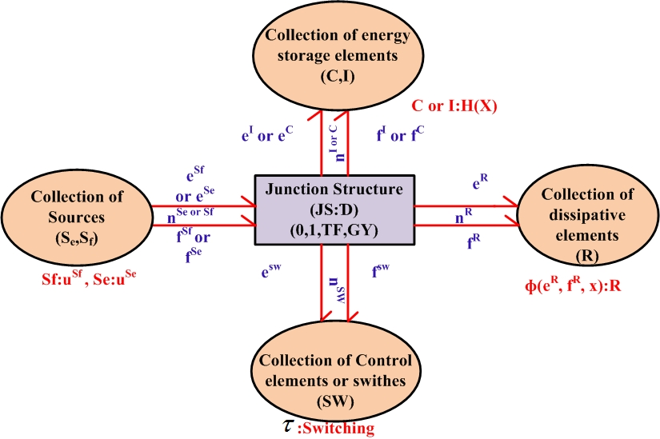
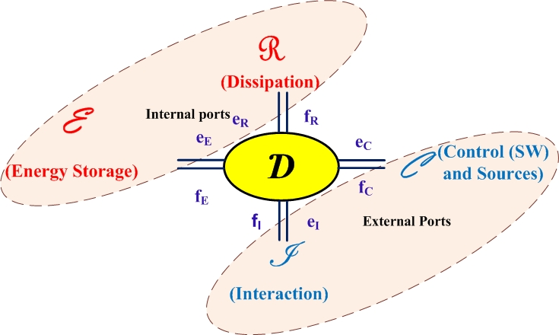
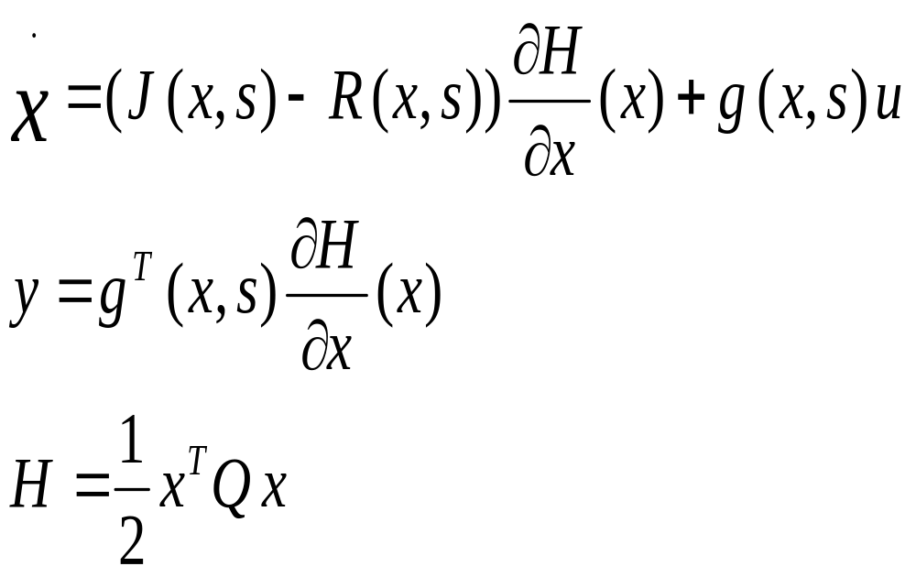
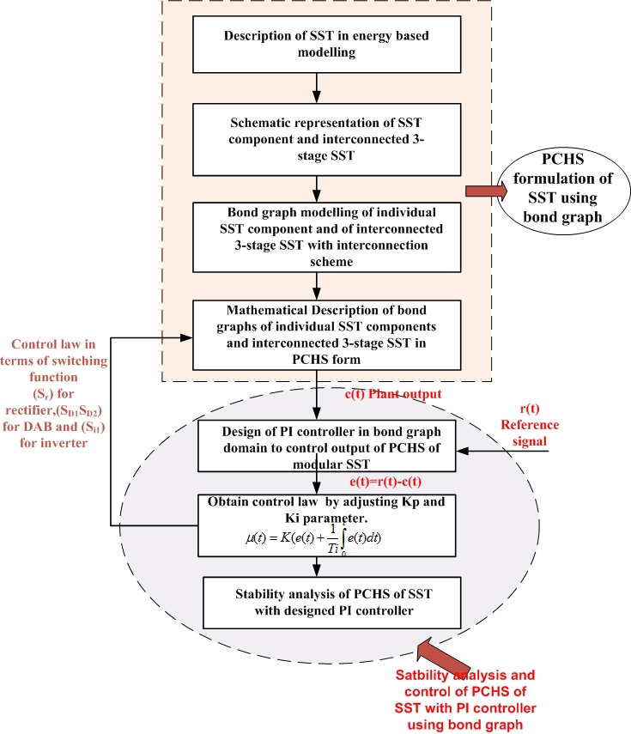
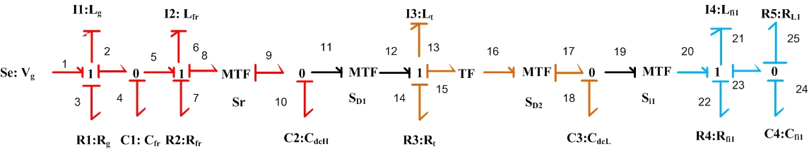
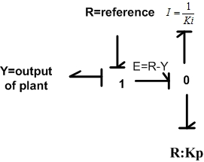
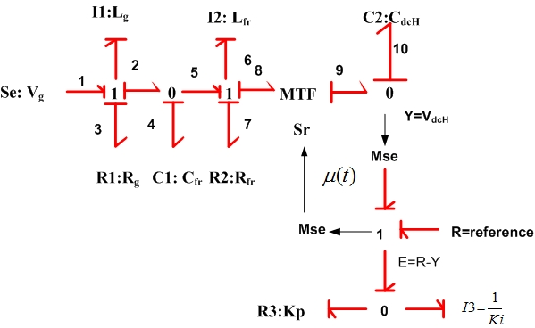
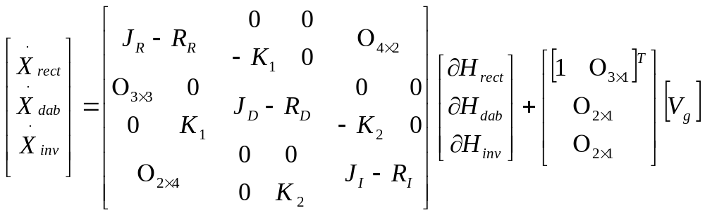
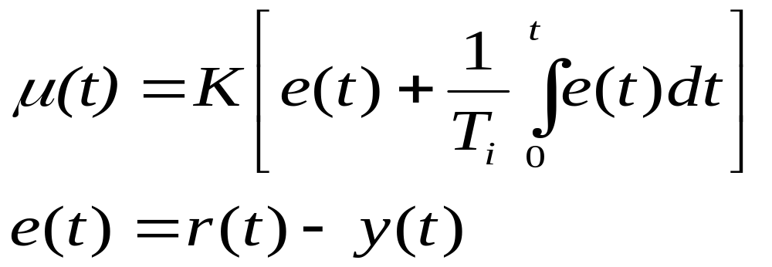
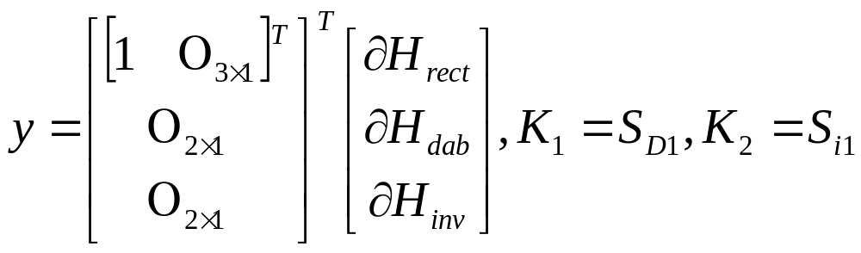
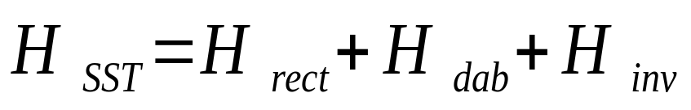
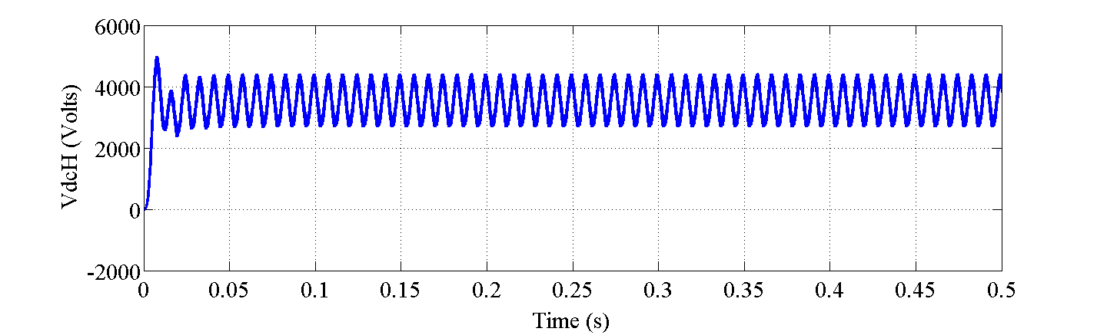
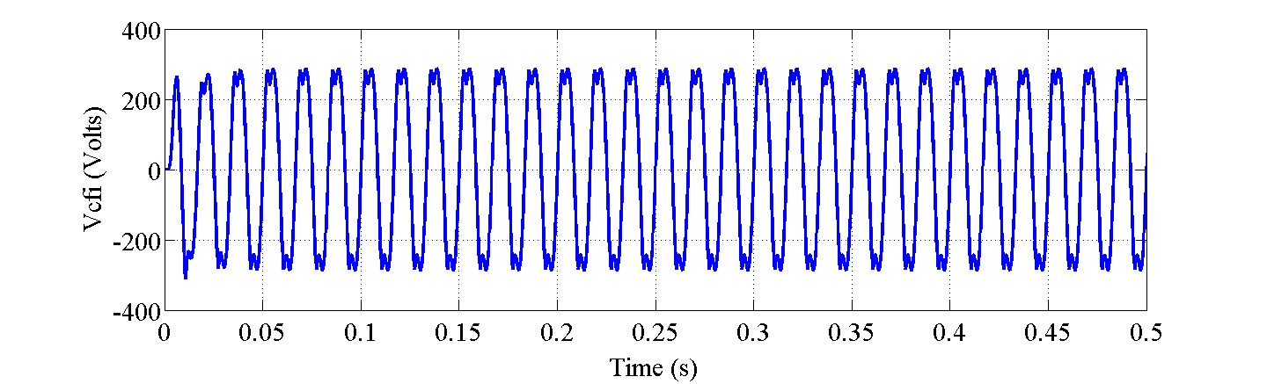
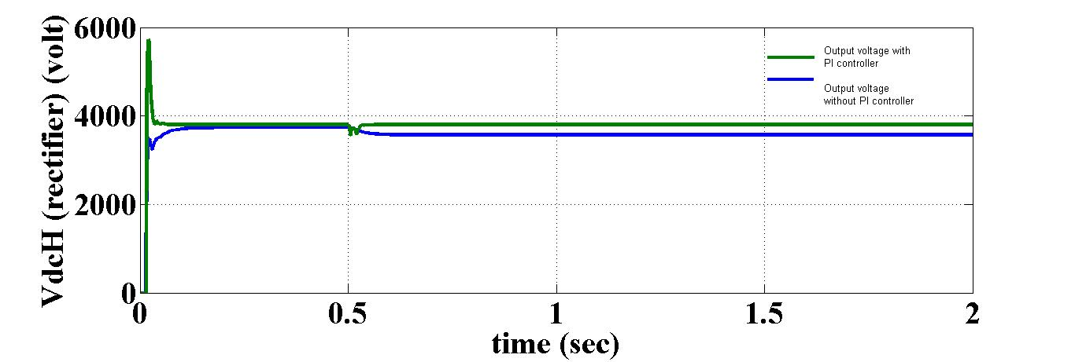
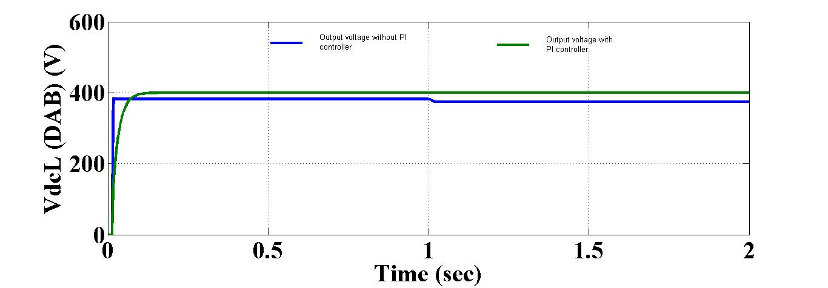
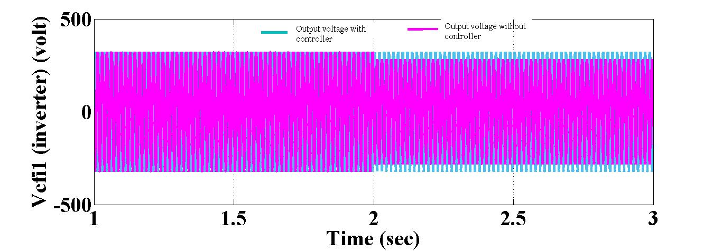
Y8.FS2.6: Hamiltonian formulation and control design using bond graph approach for 3-stage solid state transformer
S. Khade, R. Meshram, N. Singh
S. Wagh and A. Stankovic Tufts University
Objective:
Energy based model of the solid state transformer using bond graph (BG) and design of PI controller in BG domain.
Rectifier
Dual Active Bridge
Features
(
DAB
L
)
Inverter
→ Multidisciplinary
→ Permits integration of subsystems
→ Mathematical foundation for bond graph modelling
→ Describe physical systems keeping information of energy generation, storage and transfer
→ Permits implementation of Passivity Based Controllers(PBC)
→ Modularity
g
R
L
R
L
R
L
R
g
f
r
f
r
Q
Q
Q
Q
t
t
Q
Q
Q
fi
1
fi
1
+
1
3
1
3
5
Q
1
3
C
i
C
i
7
C
i
fi
1
i
f
tp
fi
1
V
g
i
C
r
V
dcH
V
V
dcL
V
R
g
c
f
p
c
1
r
i
S
S
s
S
L
1
r
r
V
D
1
S
V
i
-
V
d
c
H
D
2
dcL
cf
r
Q
Q
Q
Q
Q
Q
Q
Q
4
2
4
2
D
8
6
4
2
D
K
D
K
I
D
1
2
R
Fig. 1 Schematic representation of 3-stage Solid state transformer (SST)
→ PCHS model obtained from bond graph is useful in
study of nonlinear behavior, stability analysis and to design PI controller and passivity based
Power stabilization of interconnected 3-stage SST via Energy shaping control
Technical Approach:
PCHS formulation of SST
e
D
e
e
D
e
e
D
e
Fig. 2 Conversion of bond graph model into PCHS model
1
R
r
K
d
1
D
d
2
i
I
4
Where, x-energy variables
s-duty ratio function
u-input to system
J-interconnection matrix
R-Damping matrix
H-Hamiltonian function
g-port feature of system
Rectifier
1
DAB
K
Inverter
f
f
f
f
2
f
f
1
r
d
1
d
2
i
4
Fig. 3 Interconnection scheme for 3-stage SST
J=-J^{T}
R=R^{T}
and
g=interconnection matrix, Q= matrix containing storage elements, u=input
Fig. 4 Bond graph interconnection for 3-stage SST
Design of PI controller using BG
Fig. 5 PI controller in Bond graph domain
Accomplishments:
Fig.6 Rectifier PCHS model with PI controller in bond graph domain
PCHS for SST using BG and design of PI controller
Fig.7 Procedure of Hamiltonian formulation of SST and control in bond graph domain
SST Bond graph model validation through simulation
Performance of 3-stage SST for load change
Fig. 8 Output voltage across HVDC link for rectifier
Fig. 9 Output voltage across LVDC link for DAB
Fig. 10 Output voltage across filter capacitor of inverter
Fig. 11 Voltage across HVDC link in rectifier with controller
Next Steps:
Energy balance maintained by energy shaping and stability could be analysis
Interconnect multiple SST’s in micro grid with Bond graph technique to obtain PCHS model
IDA-PBC approach is used to design nonlinear controller
Potential Impact:
→ Bond graph describes the physical system dynamics which are related to energy relationships between system components
→ Issues of multi-domain system modelling and causality of the energy variables solve using bond graph technique
→Port-controlled Hamiltonian descriptions with hierarchical, multi-scale modeling at different levels of abstraction.
→ Evolve much faster response than the time scale at which the system behavior needs to be analyzed
Fig. 12 Voltage across LVDC link in DAB with controller
Time-domain simulations by offering sensitivities to design quantities and basis for control design
Robust control design methods by exploiting simplicity of energy flow and dissipation as a basis for effective design
Fig. 13 Voltage across filter capacitor of inverter with controller

